Slide 1
Android JArduino GUI
Android Bluetooth Arduino Controller

Slide 2
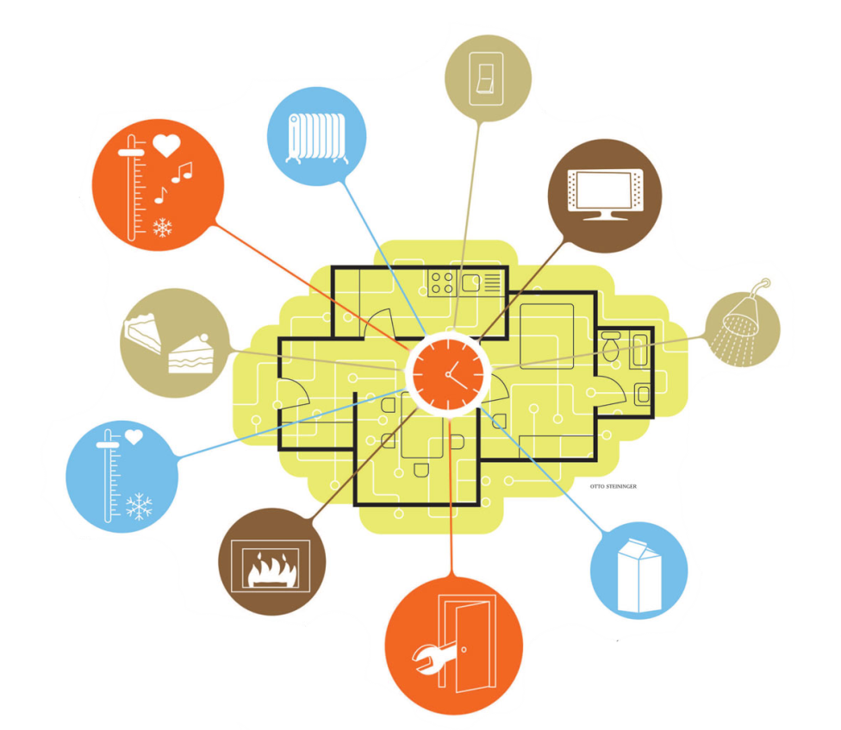
Why an Android Controller?
More and more sensors and data around us
Convenient to access and manage these from your mobile phone
  E.G. Use your mobile as a remote control of your Smart Home
Arduino is a powerful relay
Android is a powerful gateway
between sensors and the Internet

Slide 3
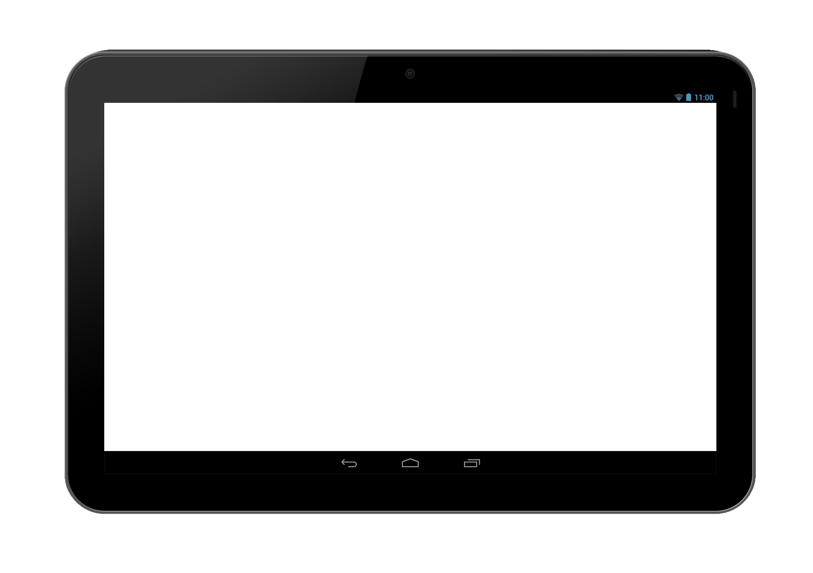

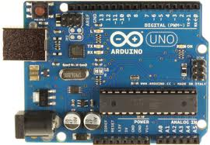


How does it work?
Mobile/tablet
Sensor
« Serial » data channel

Slide 4
JArduino Library
Arduino
  Is an open-source electronics platform based on flexible, easy-to-use hardware and software
    Allows using easily several electronics (sensors, LED, etc.)
    Single-board microcontroller
  Large user community
    see Wiki Playground: http://playground.arduino.cc/
JArduino
  Jarduino is a Java based Library to interact easily with an Arduino platform

Slide 5
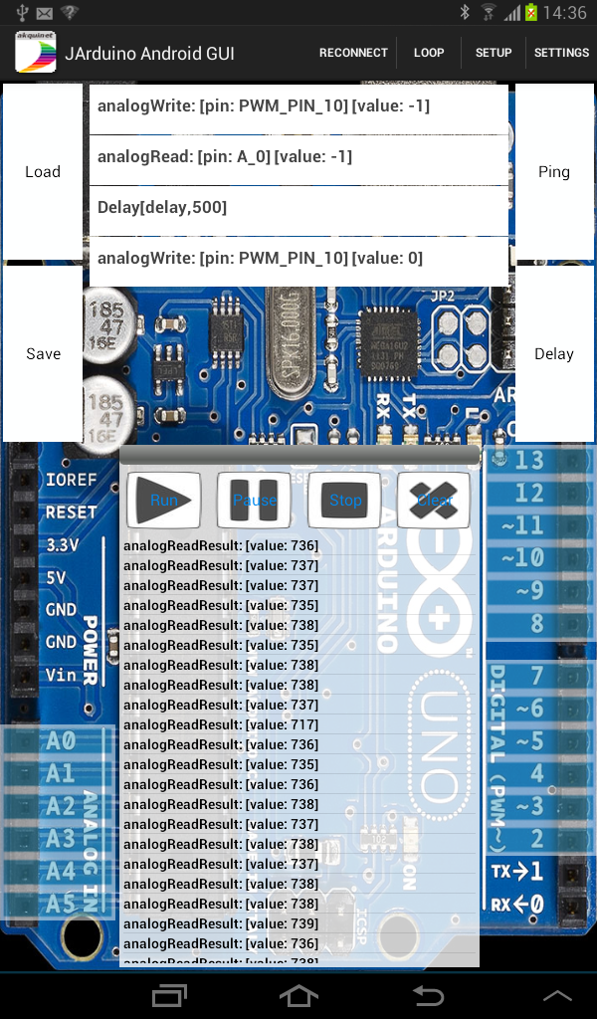
Android JArduino GUI
Order Logger
Order Runner
Received Message Logger
Order Button

Slide 6
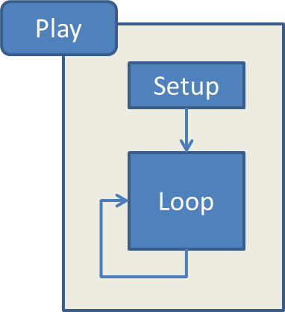
Control Messages for the Sensor
Runs the setup messages once
Loop on the « loop » messages infinitely
Pause pauses the message flow
Stop the message flow
Clear deletes all stored messages

Slide 7
Demonstration
Setup list:
  PinMode OUTPUT on pin 11
  PinMode OUTPUT on pin 10
  PinMode INPUT on pin A0
  Analog Write 255 on pin 11 (green)
  Delay 500 ms (wait)
  Analog Write 0 on pin 11 (turned off)
Loop list:
  Analog Write 255 on pin 10 (red)
  Analog Read on pin A0 (read the light sensor)
  Delay 500 ms (wait)
  Analog Write 0 on pin 10 (turned off)

Slide 8
End of Android-JArduino Demo

